Slide 1
The Network Automation Map:
Navigate Your Journey with the
NAF Automation Framework
Wim Henderickx, Nokia
Damien Garros, OpsMill

Slide 2


About Us
Wim Henderickx
Damien Garros
CTO IP Division
Nokia
Co-founder and CEO
OpsMill

Slide 3
Introduction

Slide 4

Modern networks demand automation that teams can trust, understand, and safely evolve.

Slide 5

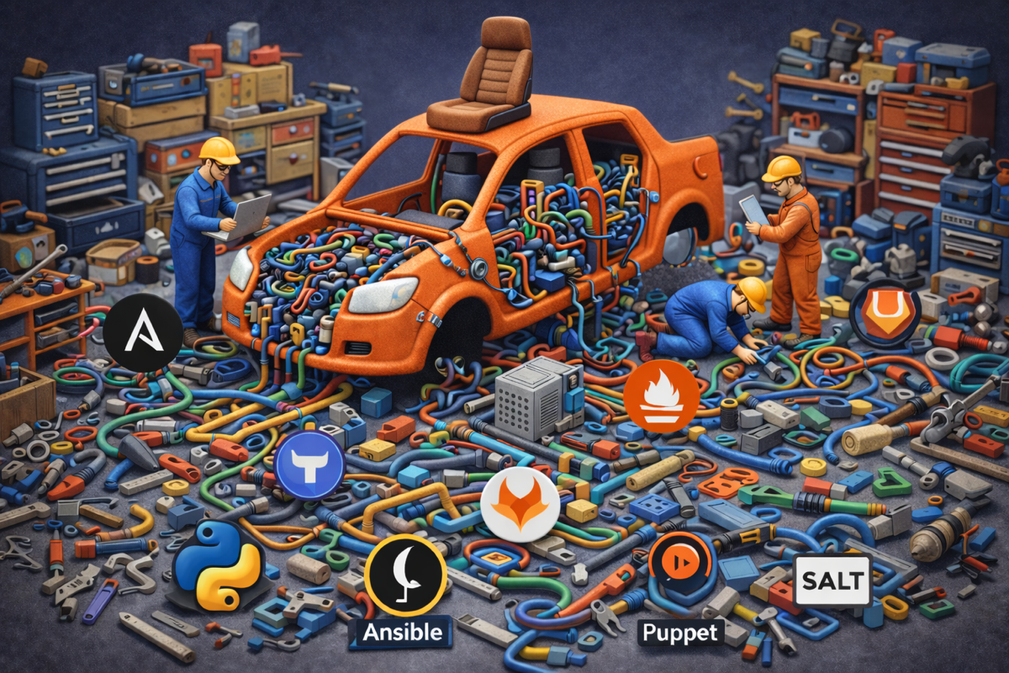
Yet, it’s still overly complicated for most organizations
Building it is hard, maintaining it is almost impossible

Slide 6
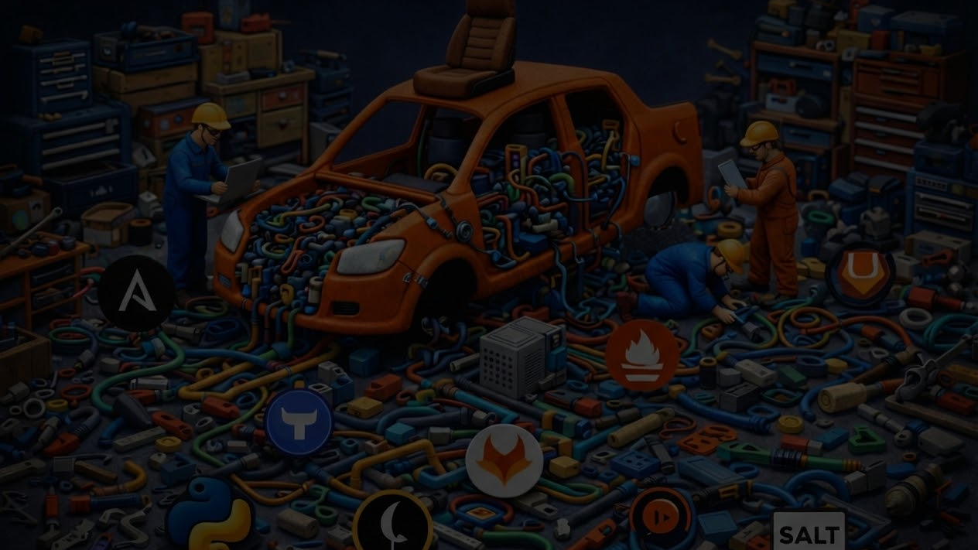
The pattern we keep seeing
Rebuild from scratch
Learn the hard way
No shared blueprint for what ‘good’ looks like
Teams keep recreating the same building blocks—data models, pipelines, integrations
Most “best practices” are discovered through outages, drift, and painful rewrites instead of repeatable patterns.
Without a common map, it’s hard to assess maturity, compare architectures, or even agree on what problem to solve first.

Slide 7


Multiple people from the NAF community got together to find a solution
It quickly turned into a working group with weekly meetings

Slide 8

It was hard at first
Everyone was biased by their own tools and habits
Ironically, we were missing a shared lexicon

Slide 9
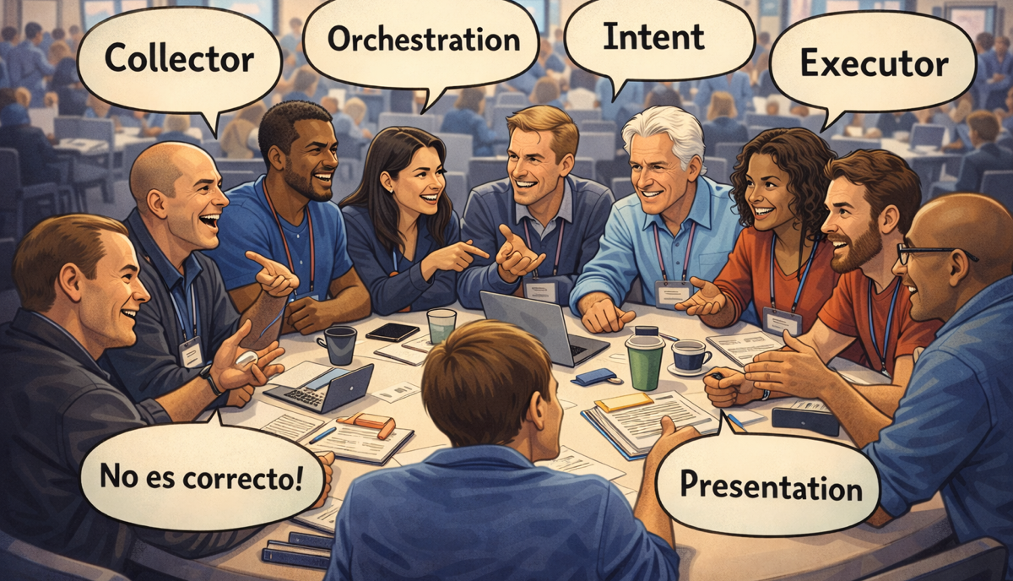
The solution was to stop focusing on tools and focus on functional building blocks
Quickly, everyone started talking the same language

Slide 10

NAF Automation Framework
Simple building blocks that underpin any network automation framework
Not a reference architecture — it’s a shared vocabulary + responsibilities.

Slide 11
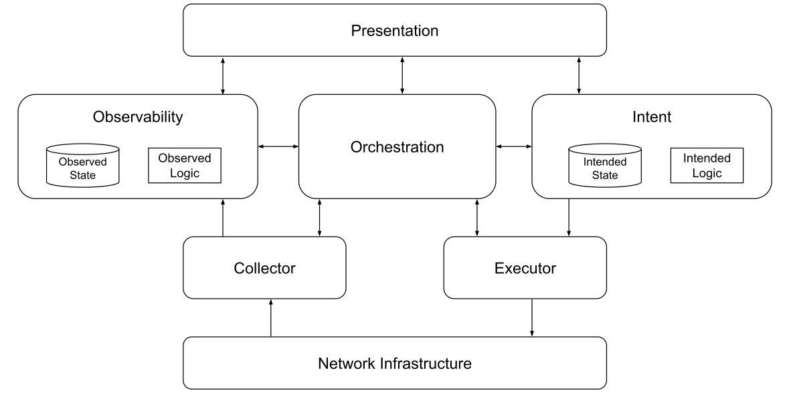
NAF Automation Framework

Slide 12
NAF Automation Framework
Fundamentals
Functional Building blocks
Both for the beginners and the experts
Living Document
Not a protocol
The NAF automation framework is meant to be tool agnostic to avoid comparing apple and orange.
Each functional building block can be map to one or more tool and each tool can map to multiple functional blocks
The NAF automation framework is meant to evolve over time.
It’s not a strict implementation that imposes a specific way of doing things and in many cases, not all components are required to get started
The NAF automation framework initiative is focusing initially on laying out the main building blocks to lay the foundation
In the future the goal is to go deeper into each block.

Slide 13
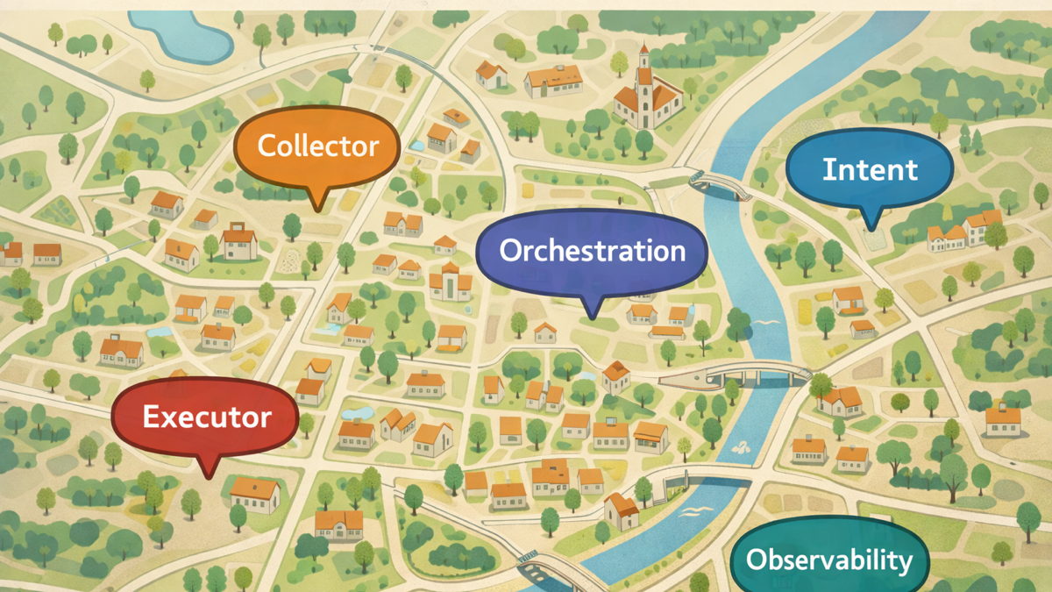
A map to help navigate the terminology and understand how things are related to each other

Slide 14
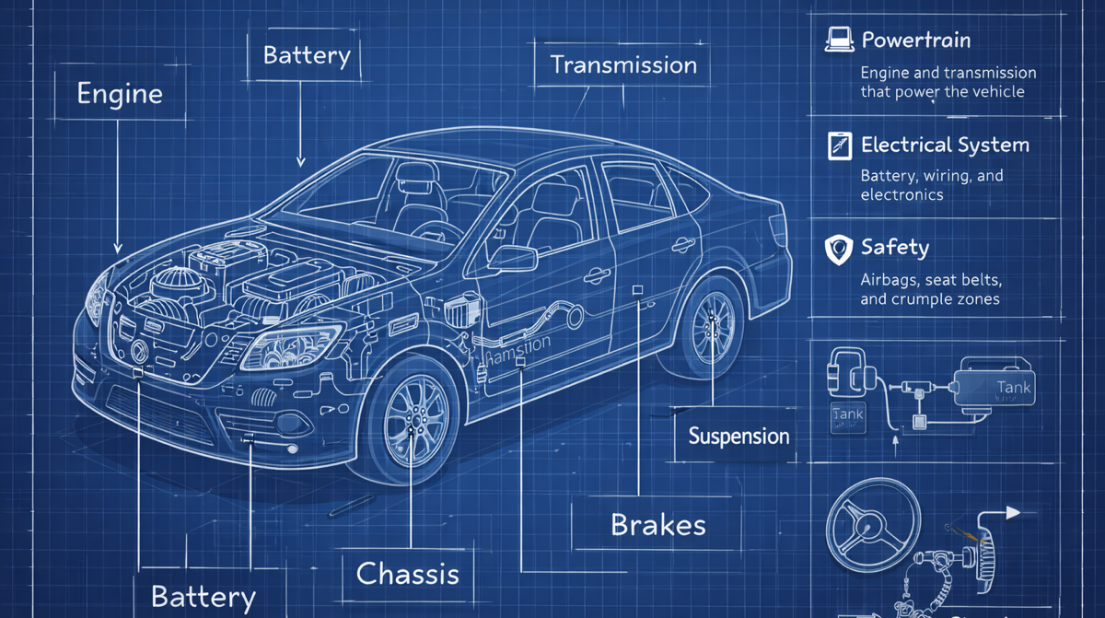
A functional blueprint to help everyone understand and build Network Automation Stack (system thinking)
Notes:
Need to explain the need to think about it as a system (system thinking)

Slide 15
Target Audience
Builders
Users
Network Automation Engineer
Automation Architect
Software Engineer
Network Reliability Engineer
Network Engineer
Network Ops
Network Architect
Engineering Manager

Slide 16

Wait, what about my tools ? Are they gone ?

Slide 17
Mapping between functional blocks and tools
Observability
Collector
Presentation
gNMIc
Each tool / product / project can map
Completely or Partially
to
One or Multiple blocks
Prometheus
Grafana
SuzieQ
Kentik

Slide 18
Where do I start ?
Do I need to implement all blocks to get started ?
No, you should only implement what is required for your use case(s)
Is there a specific order to get started ?
No, it really depends on your use case(s).

Slide 19






Ryan Shaw
Dinesh Dutt
Dinesh Dutt
Christian Adell
Christian Adell
Claudia de Luna
Claudia de Luna
Srividya Iyer
Wim Henderickx
The NAF Community
Wim Henderickx
Damien Garros
The Team behind the Working Group

Slide 20
Main functional Building blocks

Slide 21
What defines a functional building block
Purpose / Goals
Boundaries
Capabilities
A tool-agnostic function in the automation system —
a chunk of responsibilities with clear goals, inputs/outputs, and capabilities
what outcome it exists to deliver
expressed as MUST / SHOULD / MAY (requirements, not products)
what it does and what it does not do (inputs → outputs)

Slide 22
Intent

Slide 23
Intent
Defines the logic to handle and the persistence layer to store the desired state of the network, including both configuration and operational expectations.

Slide 24
Source of Truth has been the root cause of many misunderstandings within our industry.
Intent is meant to provide a more accurate definition
Source of Truth
Intent ✓

Slide 25

Intent - Introduction
Inventory
Cabling / Topology
DCIM
Circuit
IPAM
Roles/Statuses
Configuration Templates
Routing
Information
Services
What do you need to rebuild it
if the network was completely lost?

Slide 26

Why do we need the Intent

Slide 27
Declarative Vs Imperative
configure terminal
interface GigabitEthernet0/1
switchport access vlan 10
exit
Exit
write memory
interface:
name: GigabitEthernet0/1
vlan: 10
Imperative - HOW
Declarative - WHAT
Manually describe the step-by-step recipe.
If something goes wrong halfway, state may be inconsistent.
Focuses on actions
You describe the desired end state, not the steps to get there.
Easier to make idempotent and retry safely.
Vendor neutral
Focuses on outcomes

Slide 28


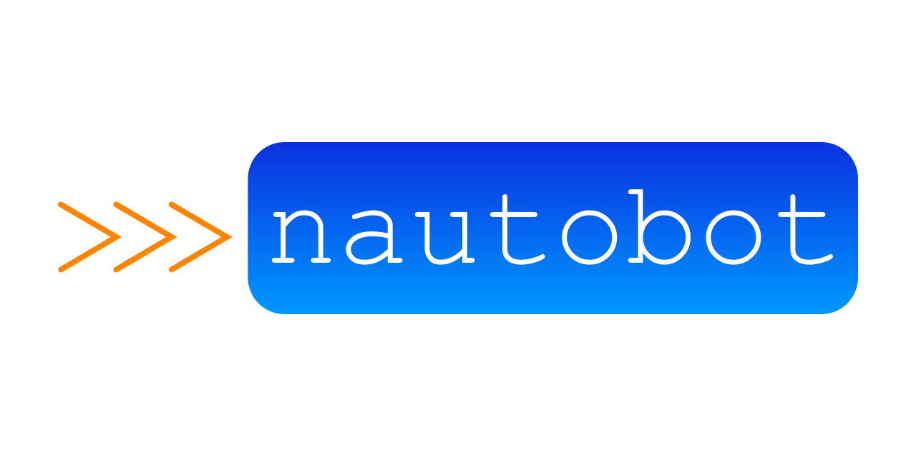

Differences between Cloud and Networking
Cloud
Networking
Optional | Optional
Declarative
Imperative

Slide 29
Intent - Requirements
MUST be capable of representing, in a structured form, any network-related aspect.
SHOULD use a neutral representation that will be derived into vendor-specific configuration artifacts
MUST support create, read, update, and delete operations
SHOULD include metadata that supports effective data governance
MUST be exposed through a standardized, well-documented API
SHOULD be transactional, and provide a versioned access to data.
SHOULD provide a consistent and unified view of the desired state
MAY include all the logic related to intended state management

Slide 30
Version
Control
Version control allows changes to be:
Prepared in isolation
Safely validated
Reviewed
and only then integrated into the main automation environment.
SHOULD be transactional, and provide a versioned access to data.

Slide 31











Version Control Workflow
Change
Test / Verify
Review
Deploy
Deploy
Change
Test / Verify
Review

Slide 32
Executor

Slide 33
Executor
Encompasses the actual tasks applied to the network to drive changes (e.g., updating configuration) as guided by the intended state.

Slide 34
Executor - Requirements
MUST be capable of interacting with any of the supported network write interfaces
SHOULD provide a dry-run operation to check the expected result of the execution
SHOULD come from the intended state or be derived from it
SHOULD support transactional execution of the changes
SHOULD support any network operation that alters the network state
MAY support both imperative and declarative approaches

Slide 35
Observability
Collector

Slide 36
Observability
Collector
Stores the actual network state, and defines the logic to process the observed data.
Focuses on retrieving (i.e., reading) the actual state of the network.

Slide 37
Observability Sources
Logs
Metrics
Traces
Flows
Packet
Captures
State
Config
Probes

Slide 38
Observability Stack: some questions to ask
Query
Event
Insights
logic
Storage
Which Data retention Policy?
Enrichment
Provide Context to the data
Normalization
Make the data vendor neutral (Optional)
Push, Pull or both?
Which protocol to use and what is supported by the vendor?
Collector
What to collect?
Static or dynamic
Can the device handle the load?
Network infrastructure

Slide 39
Observability Stack: some questions to ask
Query
Event
Insights
logic
Storage
Which Data retention Policy?
Enrichment
Provide Context to the data
Make the data vendor neutral (Optional)
Normalization
What to collect?
Static or dynamic
Can the device handle the load?
Push, Pull or both?
Which protocol to use and what is supported by the vendor?
Collector
Network infrastructure

Slide 40
Observability - Requirements
MUST support historical data persistence
SHOULD automatically generate events when discrepancies are detected
MUST offer programmatic access to this data
data SHOULD be normalized into vendor agnostic data model
SHOULD offer a capable query language to extract the data.
events MAY be processed by humans or connected to the Orchestration
SHOULD expose relevant insights into the current network state
MAY be enriched with contextual information from the intended state

Slide 41
Collector - Requirements
MUST includes capabilities for retrieving live data from the network using read interfaces (push, pull)

Slide 42
Orchestrator

Slide 43
Orchestrator
Coordinates activities across various building blocks

Slide 44


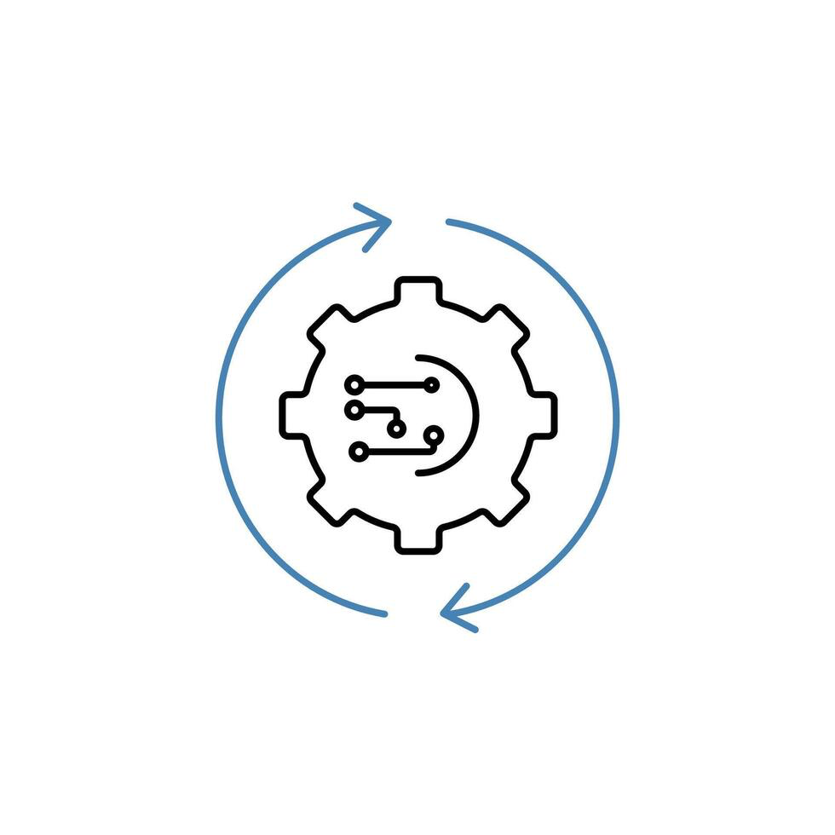
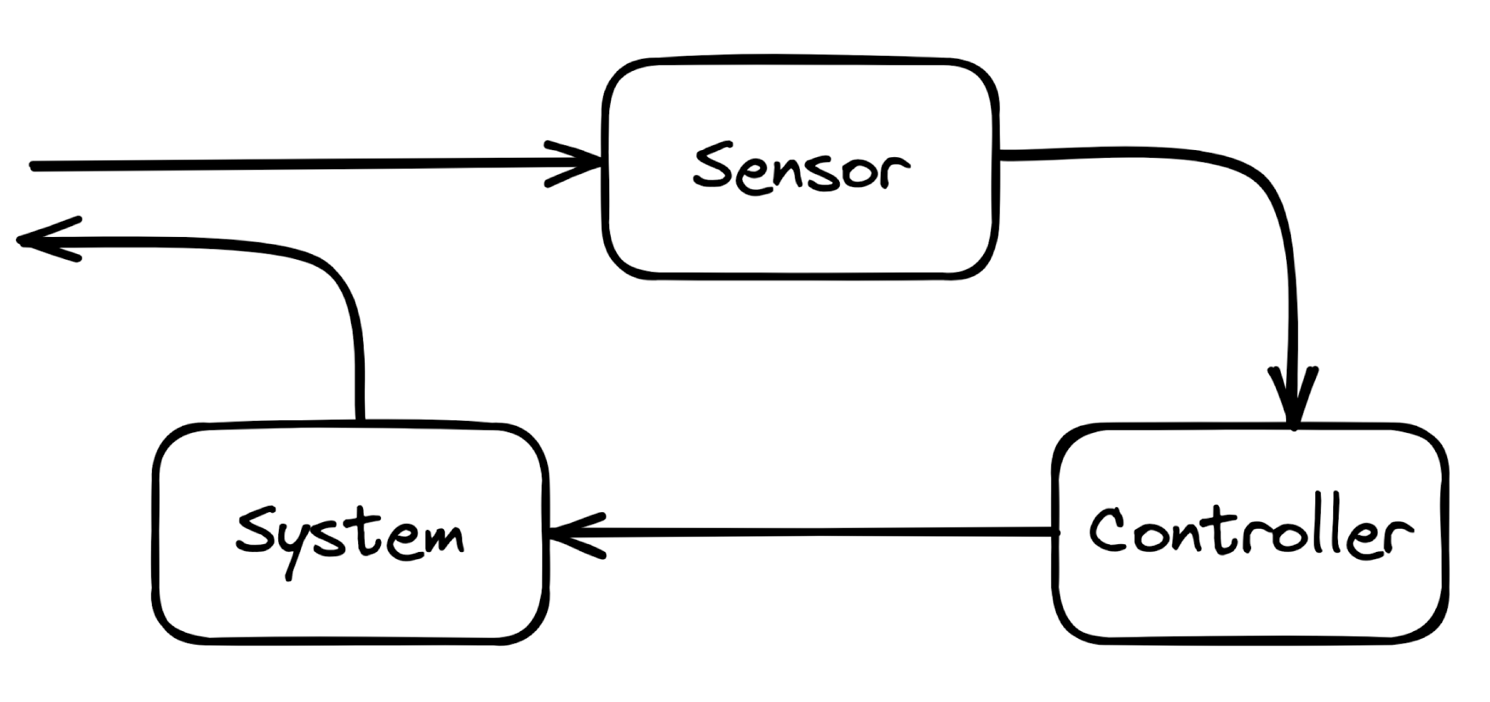
Event Driven Control Loop: Sense - Logic (Reason) - Act
Sense
Logic
Act
Runtime

Slide 45
Orchestration implementation approaches
Monolith
Workflow
Choreography
Agentic
fn
1
task
1
task
1
tool
1
fn
2
fn
3
task
2
graph
task
3
task
2
Pub
Sub
task
3
tool
2
tool
3
fn
4
task
4
task
4
tool
4
E.g. a python program
Ansible (predefined workflow)
Event driven and distributed
Agentic

Slide 46
Orchestration: Trust
TRUSTED
- controller style
NOT TRUSTED
- change log/approval style
Dry-run
Diff (before/after)
- Rollback

Slide 47
Gaining Trust: Dry Run - Rollback - Diff
Diff:
- What changed?
- Review the changes before applying to the network
DRY-RUN
BEFORE
AFTER
Rollback:
- Something bad happened, move back to a well known good state
Try the workflow without applying it to the network

Slide 48
Orchestrator - Requirements
MUST enable to coordinate processes across the various building blocks
SHOULD provide a dry-run operation to check the expected result of the workflow
Process execution SHOULD follow an event-driven approach
SHOULD provide logging and traceability of past and current workflows
Execution logic SHOULD allow for reverse/compensating actions
MAY include logic to correlate multiple events, infer relationships
SHOULD provide the ability to schedule the execution of a workflow

Slide 49
Presentation

Slide 50
Presentation
Provides the interfaces through which users interact with the system, including dashboards, graphical user interfaces

Slide 51
It is designed to interface with any of the other building blocks as required, serving as the primary point of contact between humans and the automation system, but this does not imply the need for a single pane of glass.
Presentation
It’s important to separate the presentation layer to avoid building workflows that are specific to one tool / interface

Slide 52
Presentation - Requirements
MUST provide robust authentication and authorization capabilities.
MAY take various forms depending on the needs of the end user
MAY support both read and write interactions

Slide 53
Practical Example

Slide 54
Use case: Rollout subnet 10.100.0.0/24 across 50 sites
Represent the
Status of the service
6
1
Enter: - subnet, vlan, routing
2
5
workflow
webhook
Collect the actual state
Routing, subnet, vlan, etc
4
3
Actuate the configuration to the network

Slide 55
Additional Resources

Slide 56
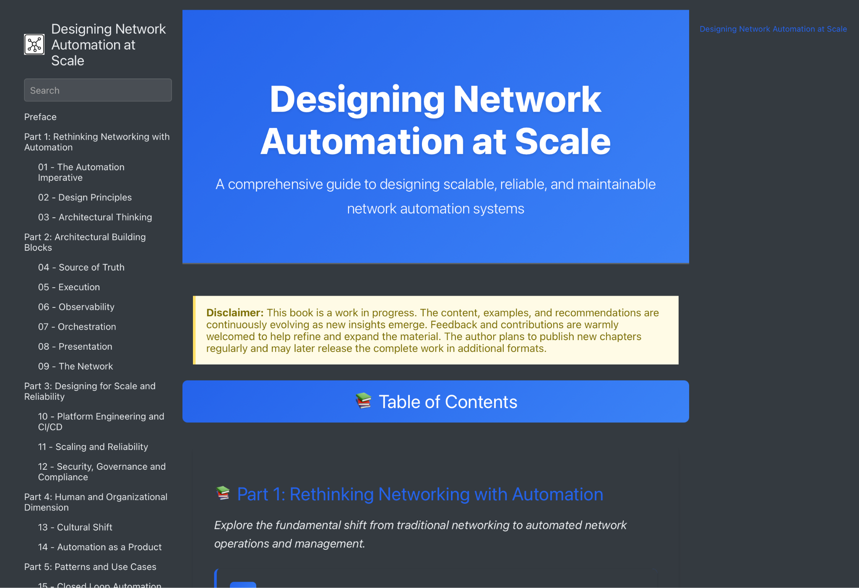
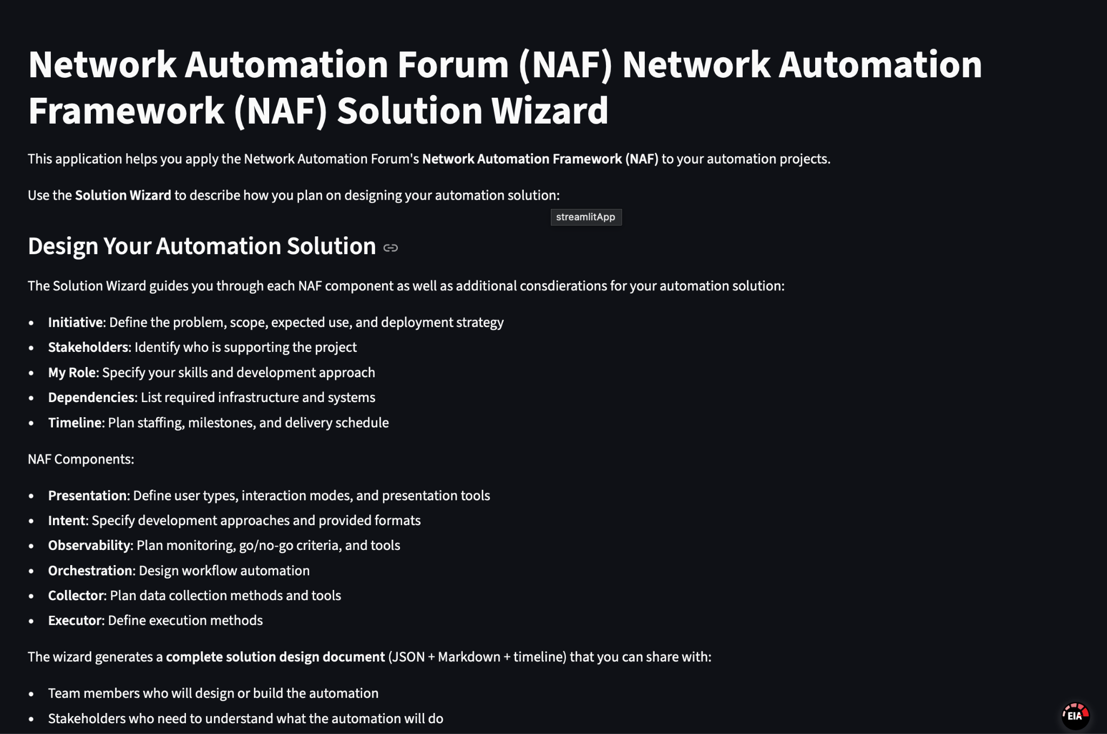
Additional Resources
https://designingnetworkautomation.com/
By Christian Adell
https://naf-naf-wizard.streamlit.app/
By Claudia de Luna

Slide 57
Summary
Not a standard, it’s a guide
You don’t need everything to get started
Think Automation as a system
Focus on functional first, tools later
Each tool can map to multiple building blocks
Don’t reinvent the wheel
Map your existing workflow toward the framework
Give us some honest feedback good and bad

Slide 58
How can you help
Use case document Github:
  https://github.com/Network-Automation-Forum/reference/blob/main/docs/Framework/Framework.md
Tool mapping
Expand details per building block
NAF Slack channel:
  https://networkautomationfrm.slack.com/archives/C082G6VGZHP

Slide 59

Questions ?

Slide 60
Agenda
Introduction Damien 5 mins
High level overview Damien 5 mins
Main Functional Building blocks
Intent Damien 7 mins
Executor Damien 3 mins
Observability + Collector Wim 7 mins
Orchestrator Wim 7 mins
Presentation Wim 3 mins
Practical Example Wim 5 mins
Additional Resources Wim 1 min
Conclusion Wim 2 mins
Questions

